Slide 1
BGP anomalies identification and analysis
Semester Project Defence
13/02/2020

Slide 2
Project objectives
Learn how internet routing works
Analyse and explore data

Slide 3
Internet routing - Border Gateway Protocol
Path vector protocol
TCP port 179
Exchanges routing information between autonomous systems
Each node stores the routing table
Actual routing path depends on many factors
Nodes exchange messages about changes in routes

Slide 4
RIS datasets
Collected by RIPE from 25 different locations around the globe
Provide information in MRT format (binary)
Update messages are dumped every 5 minutes
Full routing table is dumped 3 times a day (every 6 hours)
We selected the node located in Amsterdam

Slide 5
Next Steps
Build database from 6 months of data
Data analysis and investigation of possible prefix hijacks

Slide 6
RIPE RIS Data
6 months of data 3*30*6 = 540 dumps
Period May to October of 2019
BGP protocol has many attributes (10+)
We selected:
PREFIX
AS_PATH
TIME

Slide 7
Initial data parsing procedure
Postgres database in Docker - supports cidr data type and operations
Libbgpdump to convert MRT dump to csv file
Java app to parse csv and batch inserts to database
One thread reads and parses file (removes other attributes and IPV6)
Multiple threads batch insert the data
Organize the data to suitable format with SQL queries

Slide 8
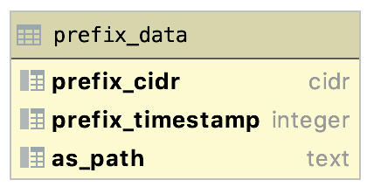
Table to dump data (I)

Slide 9
Issues with initial approach
Libbgpdump parsing
Slow ~10 minutes per dump
Lot’s of redundant data - all fields and also IPV6
Storage - ~2.2GB dump, but ~5GB raw data
Java parser was not fast enough
~20 minutes per file (540 * 20 minutes = one week!)
Organizing
Each dump has ~40 million lines -> 21,5 billion lines total

Slide 10
Parsing revised (I)
Use our java app to convert MRT dumps to csv
Fork libbgpdump command from Java and get its output as stream of lines
Remove IPV6 and other attributes
Write lines to csv
Parsing time reduced from 10 minutes to 5 even with single thread
Csv now smaller than initial dump
Instead of loading data with Java, use Postgres copy command
2-3 minutes to load single csv file
We set up the database and ran the parsing in Google Cloud

Slide 11
Parsing revised (II)
We managed to optimize the parsing and loading part
Getting the data to suitable format was still hard
Goal is to group data by prefix and path and aggregate on timestamps
We tried 3 different strategies
Load all files and group then (~21,5 billion rows)
After each dump (still ~40 million rows to group)
Line-by-line on inserting

Slide 12
Parsing revised (III)
We came up with 2 potential solutions
Process and group data in cluster to specific format before loading it to database
Big data tools such as Spark or Flink
Use horizontal scaling and process the data in-memory
We chose the latter option due to time constraints
We created python script that reads and parses the data in memory
Writes output as csv file consisting of
Runs on machine with 400GB of memory
Completes in 8 hours

Slide 13
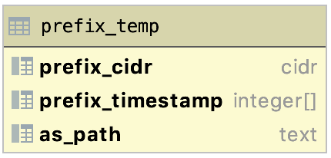
Table to dump data (II)

Slide 14
Parsing revised (IV) - Total steps
Download dumps from RIPE
Parse dumps from MRT to csv format
Scale up hardware to parse data to desired format and write output to csv
Load the csv to database using Postgres copy command

Slide 15
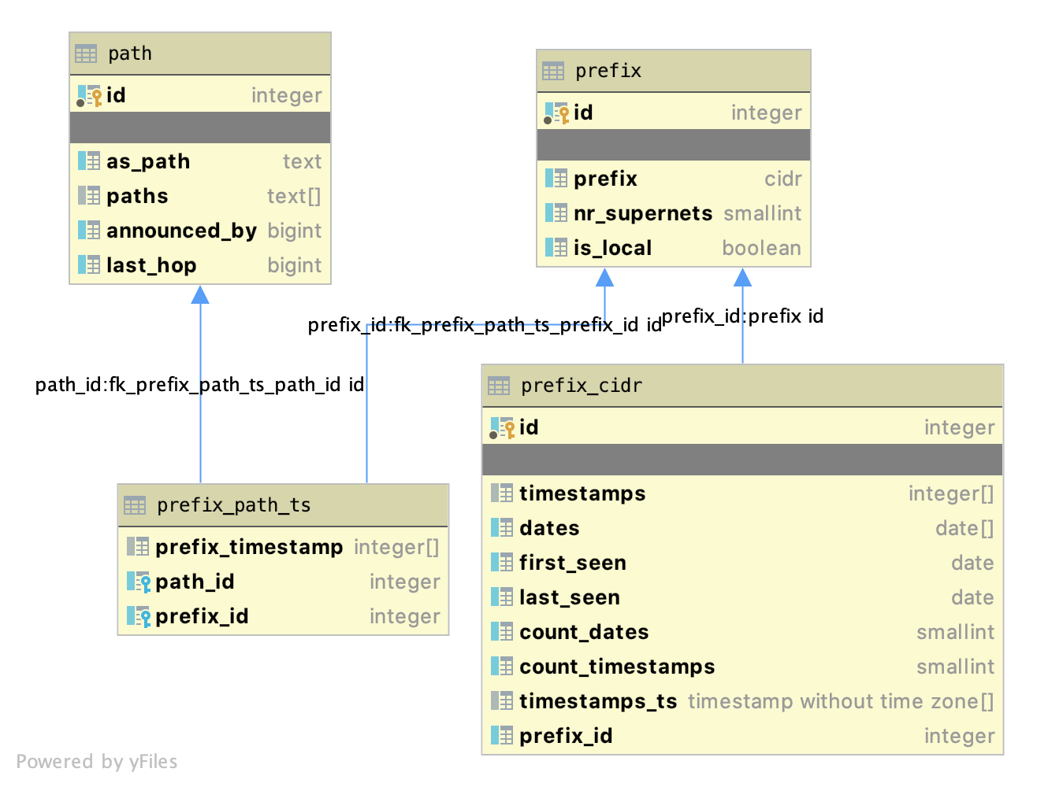
Database schema

Slide 16
Selection criteria for interesting cases (I)
We computed additional fields based on the data we already have
prefix(nr_supernets) - Number of prefixes the current prefix is part of
prefix(is_local) - Filter out bogons
prefix_cidr(first_seen, last_seen, count_dates) - Find prefixes announced for short period
We also added country codes for last_hop, announced_by from RIPE to interesting cases

Slide 17
Selection criteria for interesting cases (II)
Prefixes that are announced for at most 2 days
Remove local/bogons prefixes
Remove prefixes that are subnets of others

Slide 18
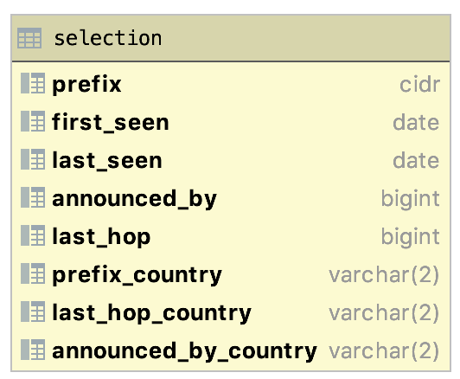
Selection table

Slide 19
ANALYZED ASNs

Slide 20
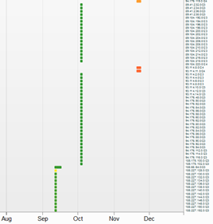
AS47582 - Anton Network Services Limited (UK)
Cloud service provider/ DDoS Mitigation
They announce a big range of prefixes, mostly in few days gap
Announcements made from China
50 prefix announcements in our database:
We analysed randomly selected prefixes:
89.184.206.0/23
188.227.130.0/23

Slide 21
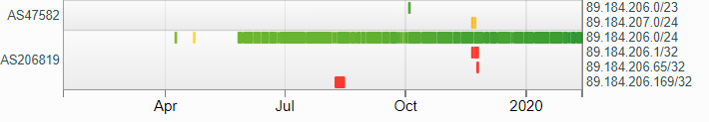
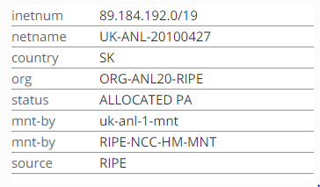
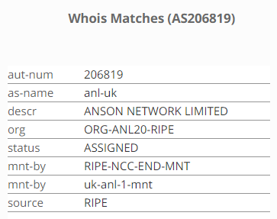
AS47582 - Anton Network Services Limited (UK)
89.184.206.0/23
AS206819 - Same Owner
Continuous announcement using other ASN

Slide 22

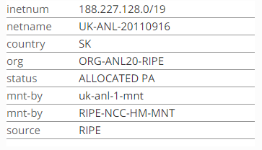


AS47582 - Anton Network Services Limited (UK)
188.227.130.0/23
AS206819 - Same Owner
Continuous announcement using other ASN
Possible DDoS Mitigation Strategy

Slide 23
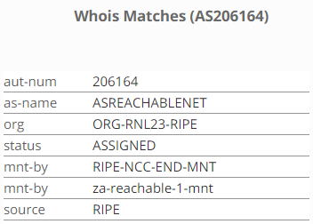
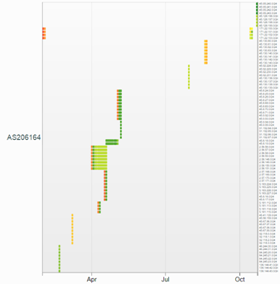
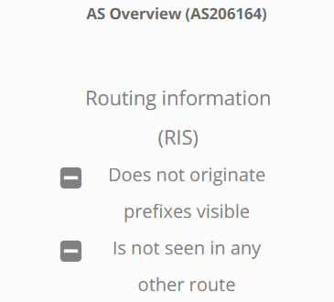
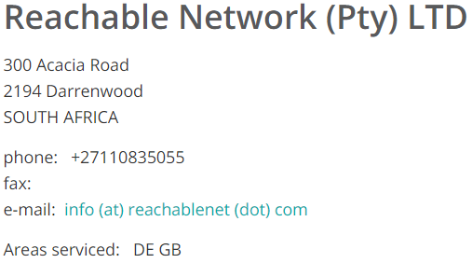
AS206164 - Reachable Network (Pty) LTD (DE)
IT Consulting and Infrastructure Management
They announce a big range of prefixes, mostly in few days gap
Mediator between clients and all Regional Internet Registries
18 prefix announcements in our database:
We analysed randomly selected prefixes:
171.22.101.0/24
45.95.241.0/24

Slide 24
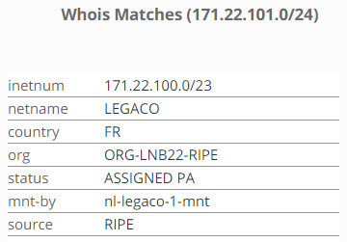

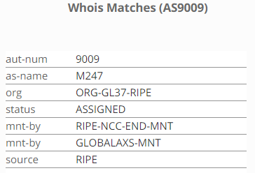
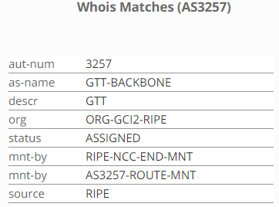
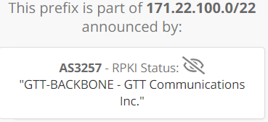
AS206164 - Reachable Network (Pty) LTD (DE)
171.22.101.0/24
m247.com, a network and cloud company based in the UK.
GTT, US based IP networks company (Started announcing /22 block)

Slide 25

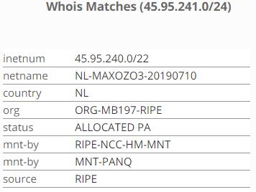
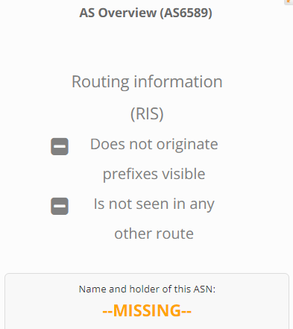
AS206164 - Reachable Network (Pty) LTD (DE)
45.95.241.0/24
Owned by Maxozo BV
Announced as /16 earlier by AS6589
AS6589 - No info on Ripe
AS6589* - BTCPROD - Beneficial Technology
Possible Sale of prefix blocks ?
*http://www.bgplookingglass.com)

Slide 26

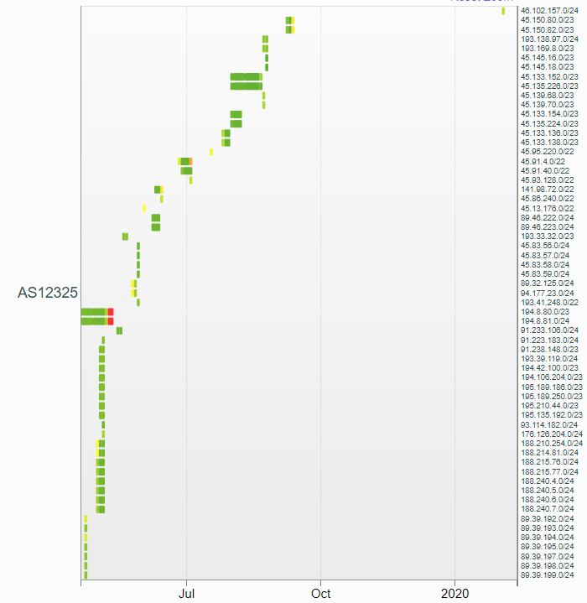
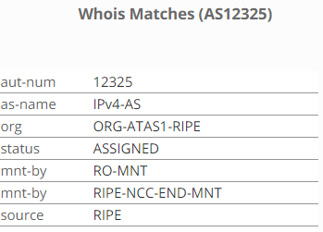
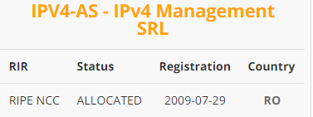
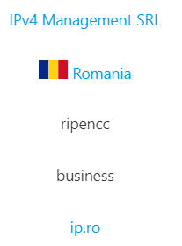
AS12325 - IPv4 Management SRL
Domain registration and IP management services
They announce a big range of prefixes, mostly in few days gap
We analysed randomly selected prefixes:
193.138.97.0/24
45.83.58.0/24

Slide 27

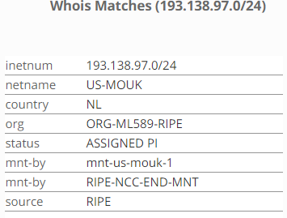
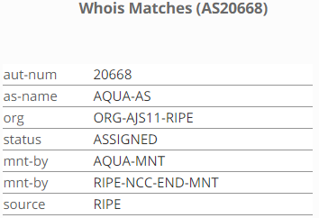
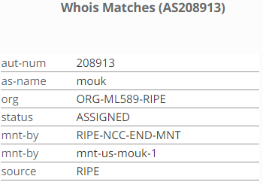
AS12325 - IPv4 Management SRL
193.138.97.0/24
AS20668 - AQUA JUMP SRL => IPv4 Management SRL
AS208913, Mouk LLC (Netherlands)
Possible sale ?

Slide 28
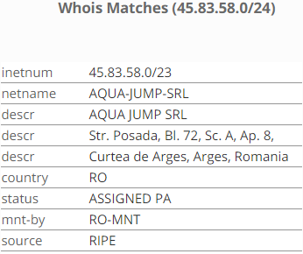

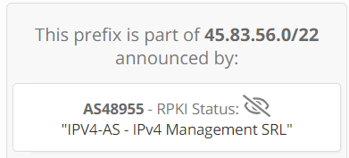
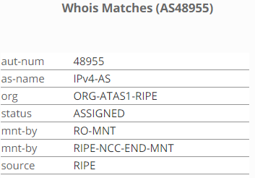
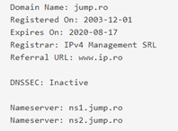
AS12325 - IPv4 Management SRL
45.83.58.0/24
AS48955 => IPv4 Management SRL
Looks legit, possible sale of blocks/ management of blocks

Slide 29
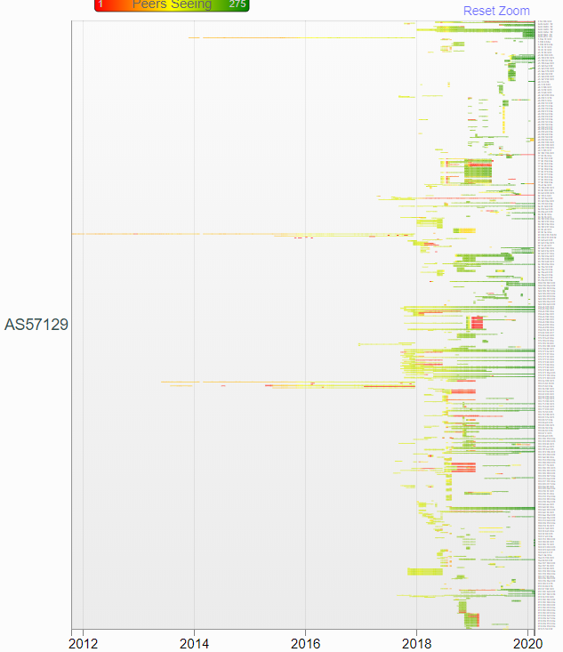
AS57129-OPTIBIT LLC (RUSSIA)
Cloud service provider
They announce a big range of prefixes, some constantly, some for short time
Rated as high Fraud Risk ISP by Scamalytics
4 Prefix announcements in our database:
46.58.0.0/17
124.242.0.0/16
178.171.112.0/22
98.9.128.0/17

Slide 30
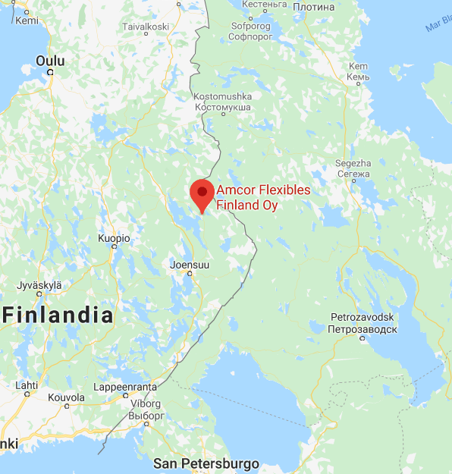

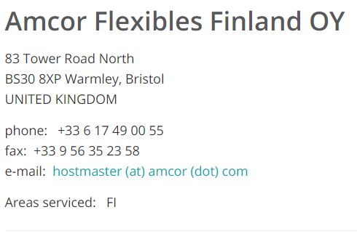
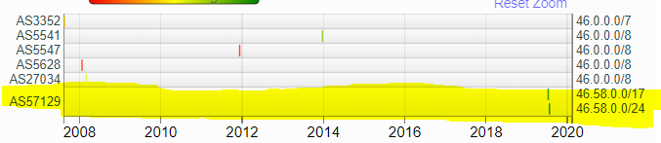
AS57129-OPTIBIT LLC (RUSSIA)
46.58.0.0/17

Slide 31
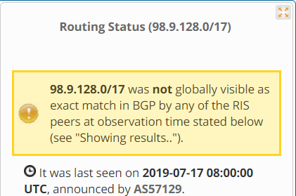
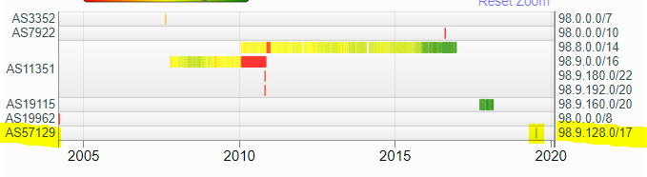
AS57129-OPTIBIT LLC (RUSSIA)
98.9.128.0/17
Unallocated block?

Slide 32

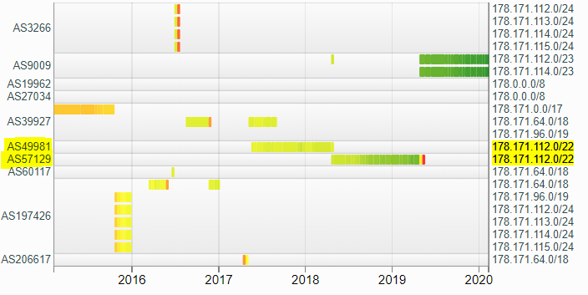
AS57129-OPTIBIT LLC (RUSSIA)
178.171.112.0/22

Slide 33
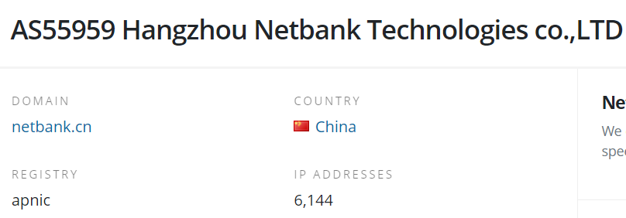
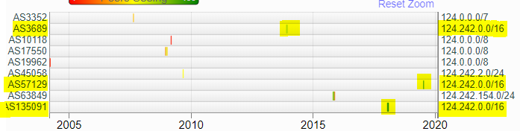
AS57129-OPTIBIT LLC (RUSSIA)
124.242.0.0/16

Slide 34
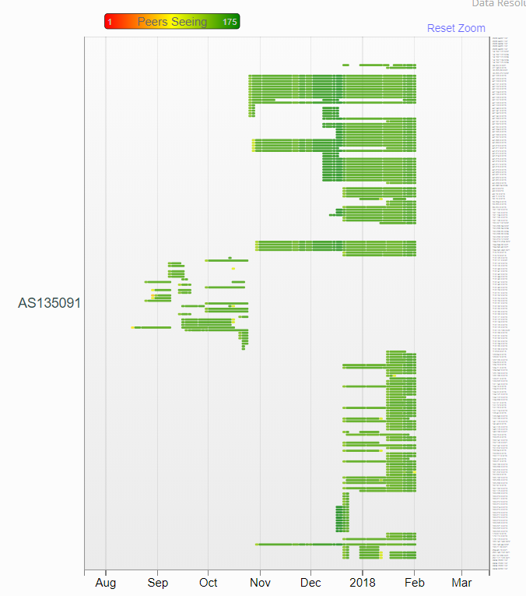

AS135091-POSSIBLY LIZARDS (SINGAPORE)
Registered in UK
They announced same prefix as Optibit, but in 2018
They announce many prefixes they don’t own

Slide 35

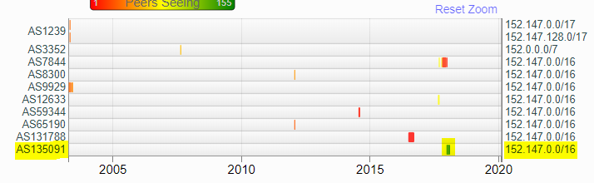
AS135091-POSSIBLY LIZARDS (SINGAPORE)
160.188.0.0/16
Okuma Corporation (Japan)
152.147.0.0/16
Housing Vic (Australia)

Slide 36
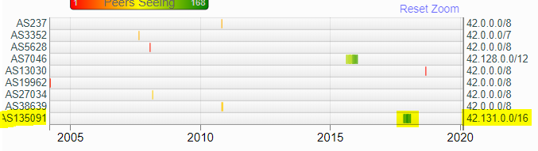
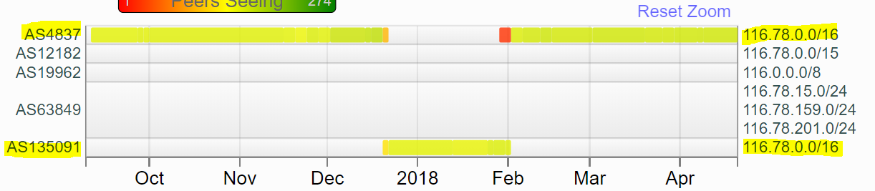
AS135091-POSSIBLY LIZARDS (SINGAPORE)
42.131.0.0/16
NorthStar (China)
116.78.0.0/16
China Unicom

Slide 37
AS27884-CABLECOLOR S.A. (HONDURAS)
Telecommunication company
Looks like a legit Internet provider
They regularly announce addresses they own
One day they announced many prefixes they don’t own

Slide 38
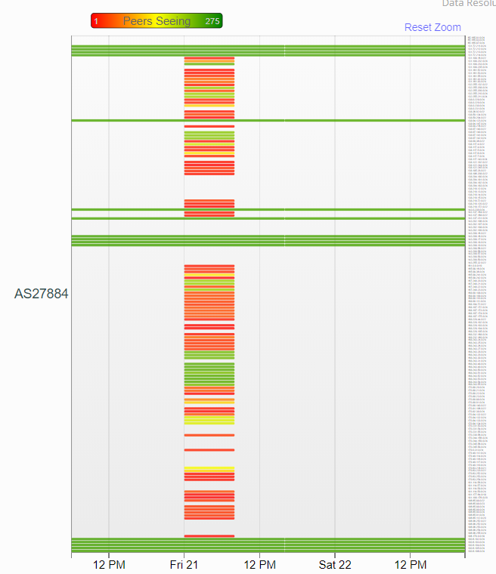
AS27884-CABLECOLOR S.A. (HONDURAS)
21th June 2019 they announce many prefixes from 131.x.x.x to 190.x.x.x
These prefixes are not owned by same company

Slide 39
Thank you for attention!
CODE & REPORT: https://github.com/vahurvar/bgp-parser

